Slide 1


Finals Pitch

Slide 2

Energy communities inclusive of residents vulnerable to energy poverty
Finals Challenge

Slide 3

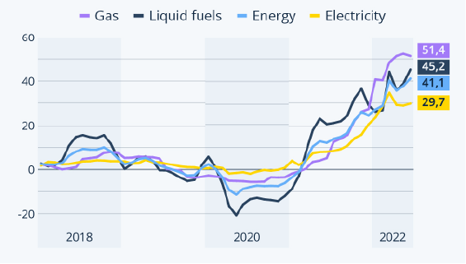
Introduction
Problem:
Worldwide severe energy crisis.
Prices of natural gas, electricity and oil are reaching record highs.
Painfully high inflation, pushing families into poverty.
Yearly rate of inflation of various energy types in the EU (in %).
Source: https://ec.europa.eu/eurostat/web/products-eurostat-news/-/ddn-20220225-2

Slide 4
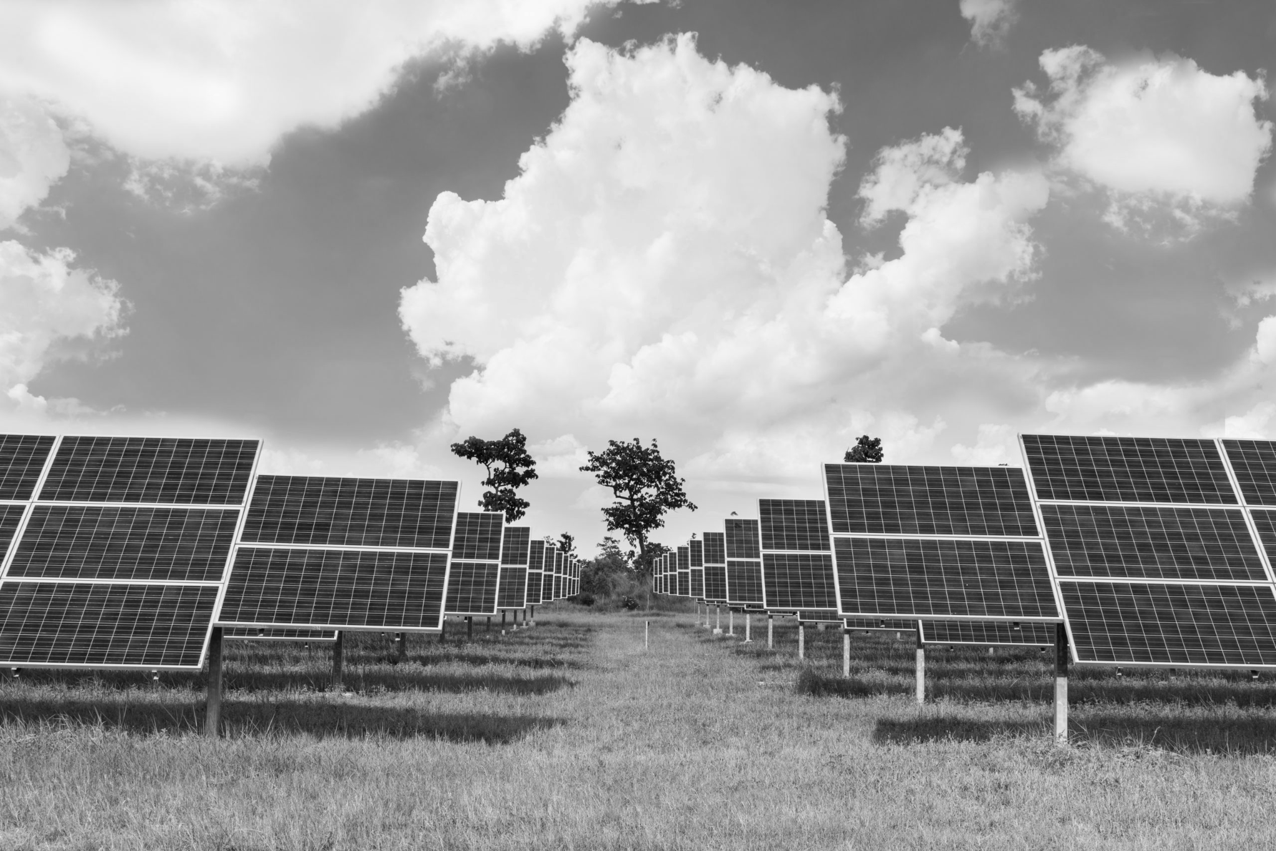



Introduction
Goal:
Cleaner and sustainable renewable energy.
Reduce inequalities.
United Nations’ Sustainable Development Goals (SGDs):
Source: https://sdgs.un.org/goals

Slide 5
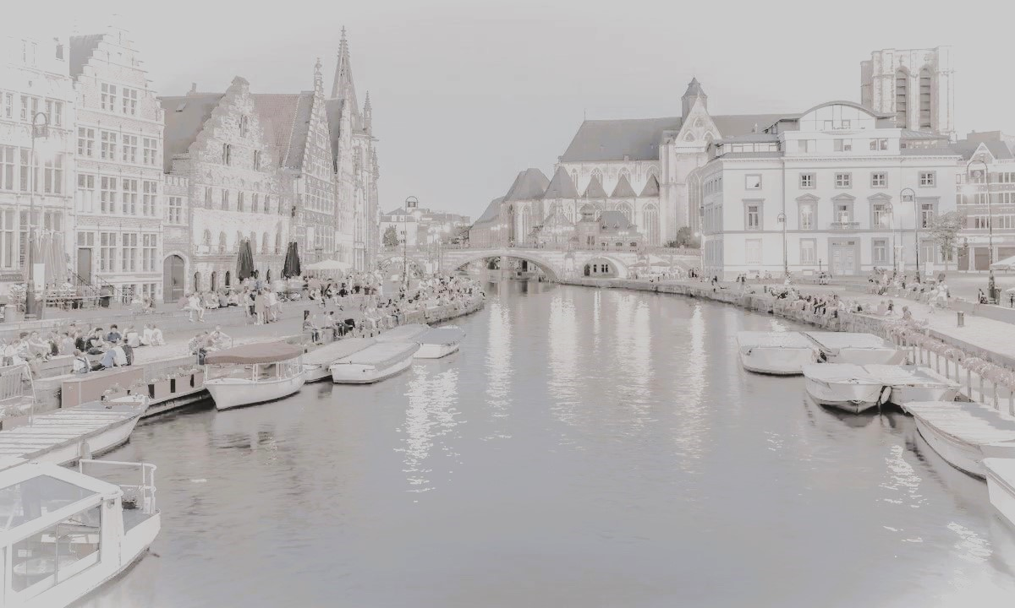
Ghent Use-Case
The city of Ghent has huge ambitions in the fields of energy efficiency and sustainability and has been one of the ambassadors to help announce and implement the SGD’s in Belgium.
Energy communities are an effective way to allocate and distribute energy in an equitable manner.

Slide 6

Solution
A tool, based on A.I. optimization algorithm, that indicates how energy communities can be formed, mitigating the unsustainability of current energy production and energy poverty.

Slide 7

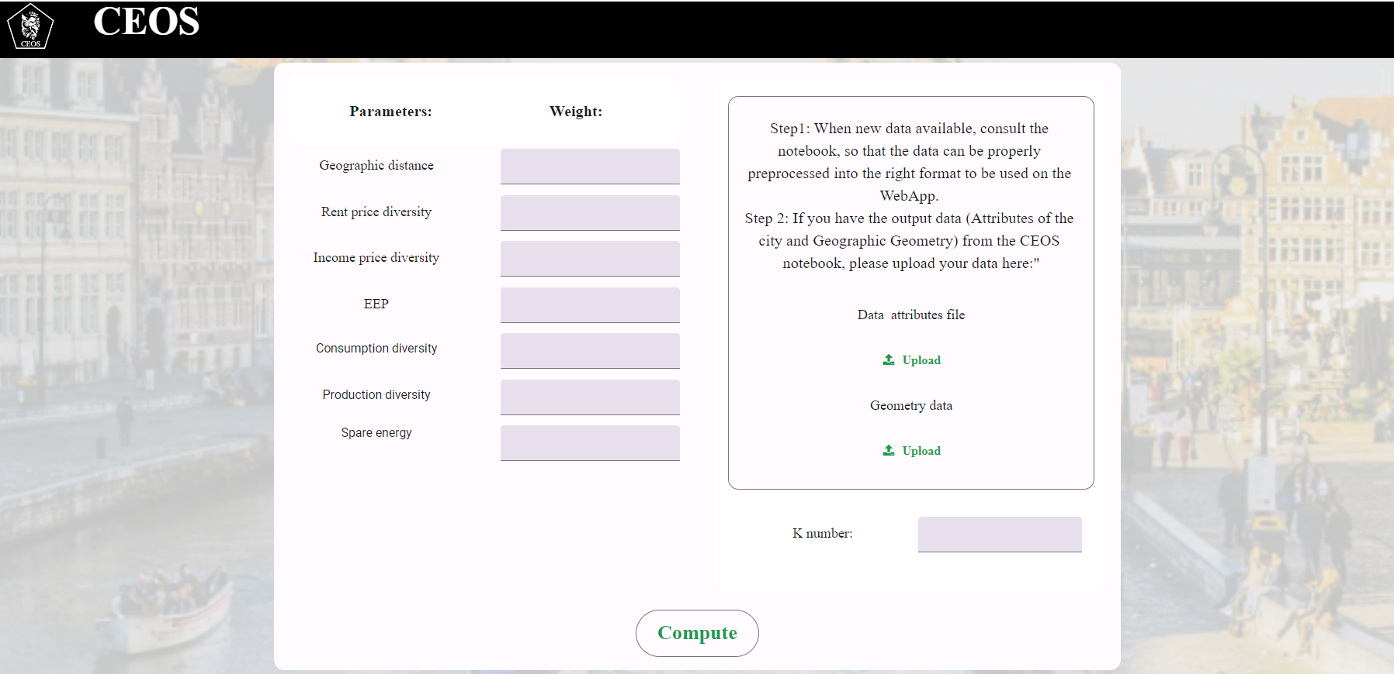
Eu acho que ha alteracoes que faltam. Tipo o EEP, o compute passar para generate
Colocar communities em vez de K
EEP mete por extenso como Estimated solar energy
Adiciona um botao de export e se fores por fake images, mete aquelas que tem o mapa por tras
Product & its features
Data Input
End-users:
urban planners
energy consultants
local government officials (OCMW)
stakeholders involved in sustainable energy planning
Customization
Optimization via Clustering

Slide 8
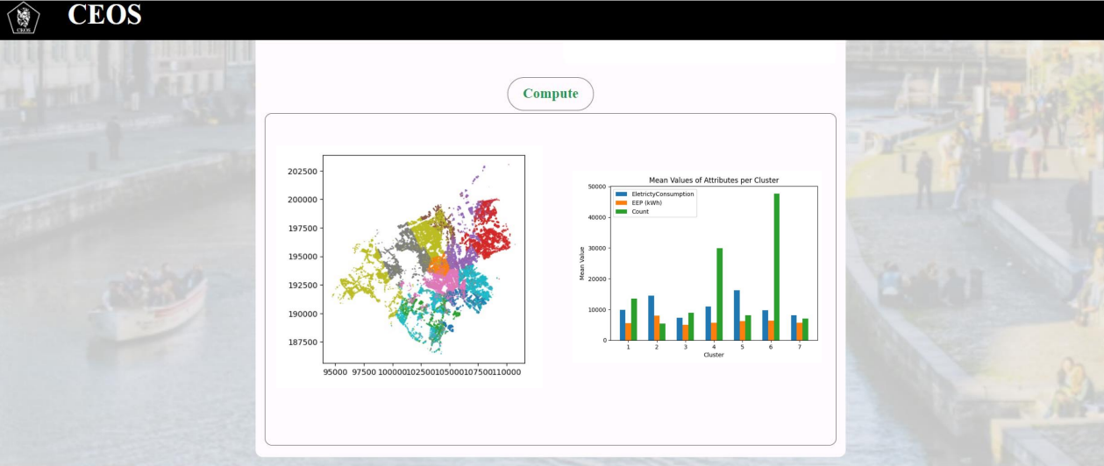
End-Users & Features
Visualization and Export

Slide 9






Social & Energy Data
Rent
Prices
Income
Geographical Proximity
Electricity Consumption
Energy
Production
Estimated
Solar Energy Production

Slide 10
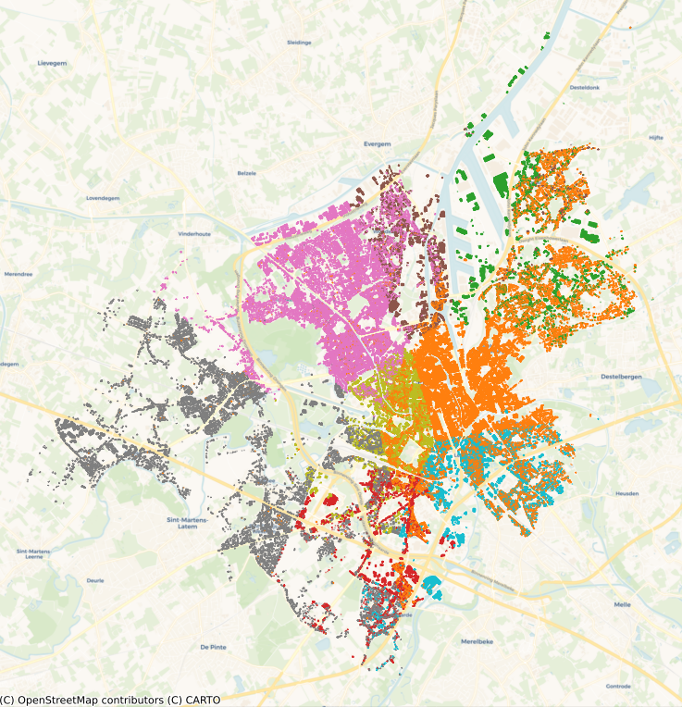
Product Demo

Slide 11
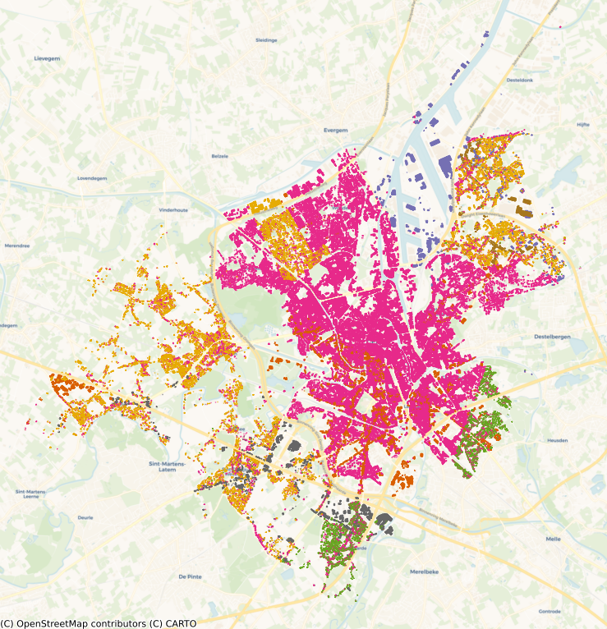
Product Demo

Slide 12
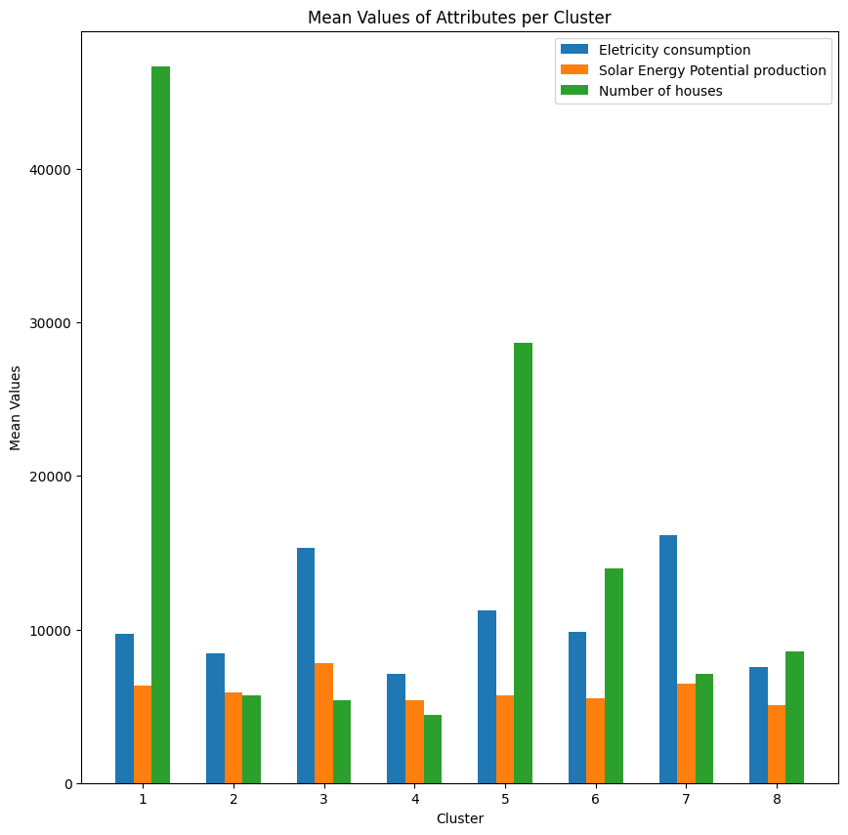
Value Proposition
No produced energy is returned to the grid.
At least, 35% of electricity is saved in this scenario.
With the same data format, the platform adapts to other cities.
Energy balance for each of the resulting communities.

Slide 13






Estimated Social Impact
Increase at least 16% per year in the usage of renewable energy sources.
Increase in the number of existing energy communities at a varying rate.
Decrease in at least ~30% in energy prices, giving many people facing poverty the ability to afford it.
Source: https://smarten.eu/report-energy-communities-to-increase-local-system-efficiency-february/
https://essd.copernicus.org/articles/11/1783/2019/
https://cleanwatts.energy/energy-communities/
Notes:
https://smarten.eu/report-energy-communities-to-increase-local-system-efficiency-february/
Friedlingstein, Pierre; Jones, Matthew W.; O'Sullivan, Michael; Andrew, Robbie M.; Hauck, Judith; Peters, Glen P.; Peters, Wouter; Pongratz, Julia; Sitch, Stephen; Le Quéré, Corinne; Bakker, Dorothee C. E. (2019). "Global Carbon Budget 2019". Earth System Science Data. 11 (4): 1783–1838. Bibcode:2019ESSD...11.1783F. doi:10.5194/essd-11-1783-2019. ISSN 1866-3508. Archived from the original on 6 May 2021. Retrieved 15 February 2021.
https://cleanwatts.energy/energy-communities/

Slide 14






Team
MSc. Duarte Rodrigues
Biomedical Engineer
MSc. Mariana Xavier
Biomedical Engineer
MSc. Mariana Sousa
Industrial Management Engineer
MSc. Ana Maria Sousa
Biomedical Engineer
MSc. Ricardo Brioso
Biomedical Engineer

Slide 15
Thank you!

Slide 16
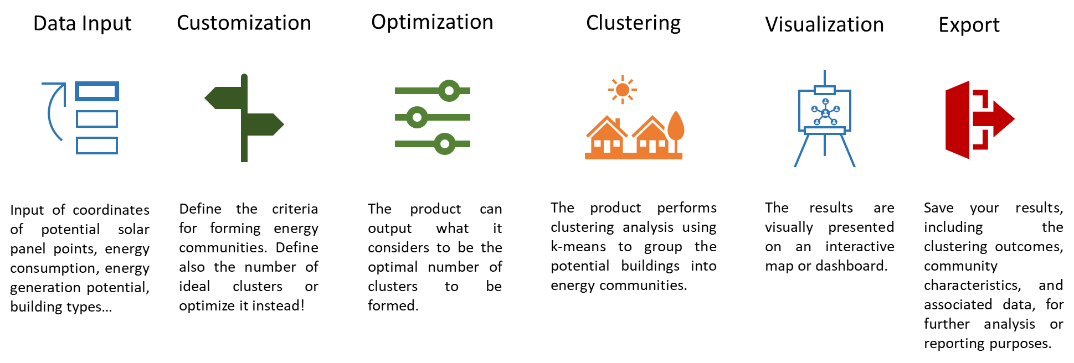
Its features

Slide 17



Solution
A tool, based on A.I. optimization algorithm, that indicates how energy communities can be formed mitigating the unsustainability of current energy production and energy poverty
The primary users of this product would be urban planners, energy consultants, local government officials (OCMW), and stakeholders involved in sustainable energy planning and community development.

Slide 18
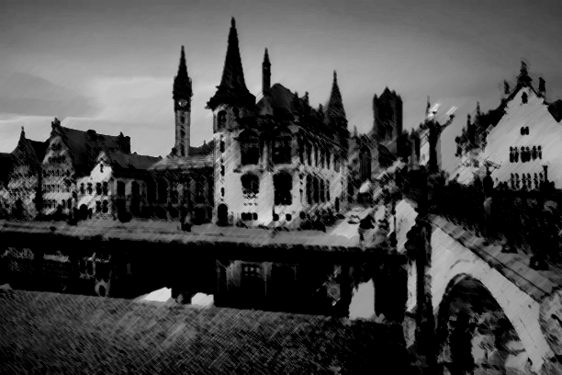

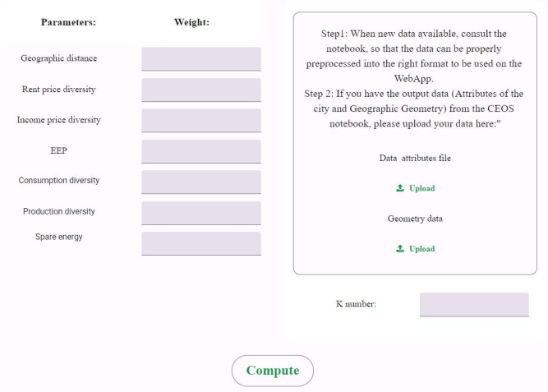
Product Demo

Slide 19


Value Proposition
To reorder a entire city electricity grid, combining the buildings and households with the most diverse social and energy status
Guarantees that the energy communities are organized so that all of them are producing energy that is sure to be used
Allows for different cities to customize their interests of what is a good community, creating arrangements based on the importance given

Slide 20
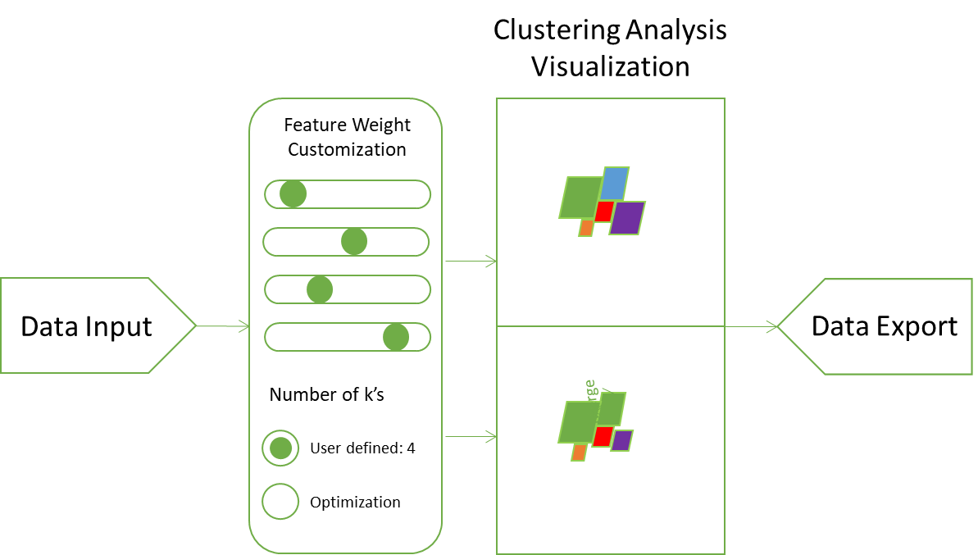
Its features!
Web-based platform that offers a user-friendly interface for energy community planning, clustering, customization and visualization.
Falar dos tipos de dados de entrada que sao necessários - mostrar que o contexto social é uma grande parte do produto

Slide 21
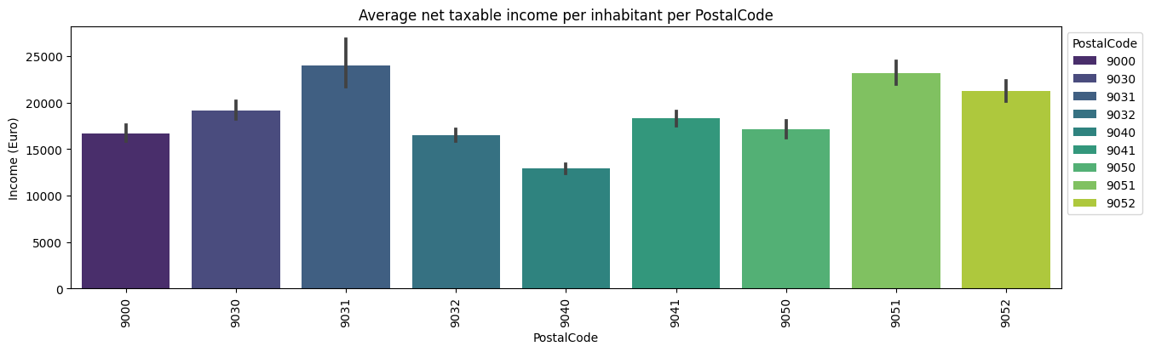
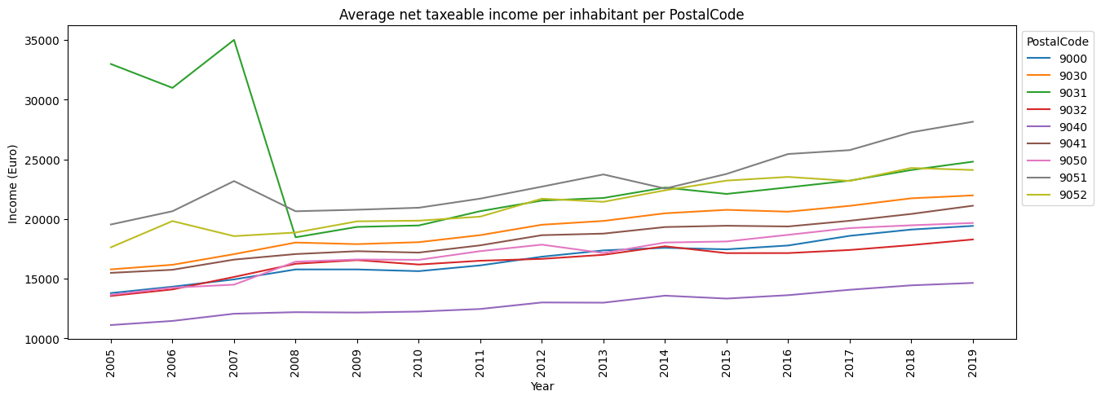
EDA - Average Income

Slide 22
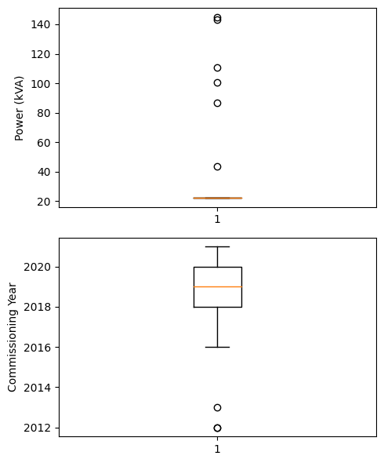
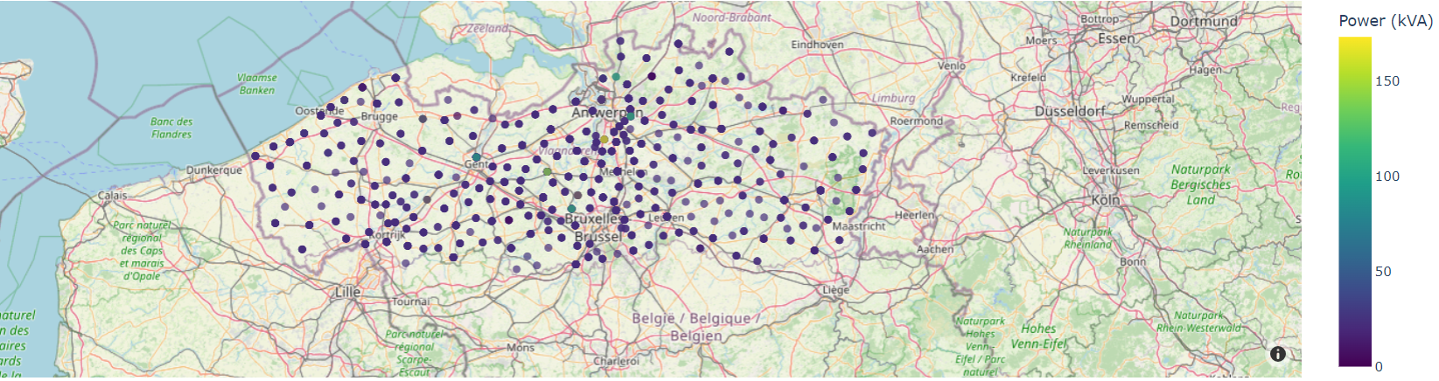
EDA - EV Charging Points
Number of EV Charging Points: 187
Average Power (kWA): 24.9 +- 15.9
Average Comissioning Year: 2019

Slide 23
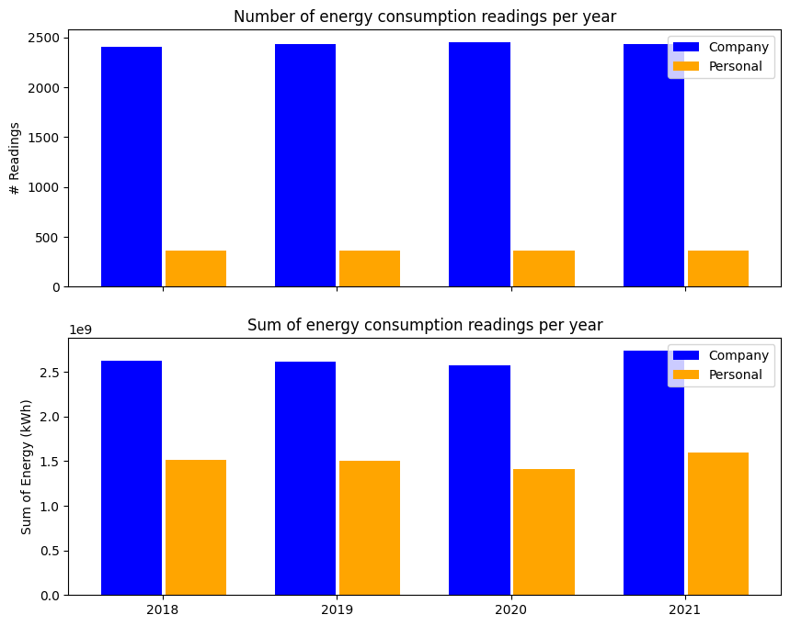
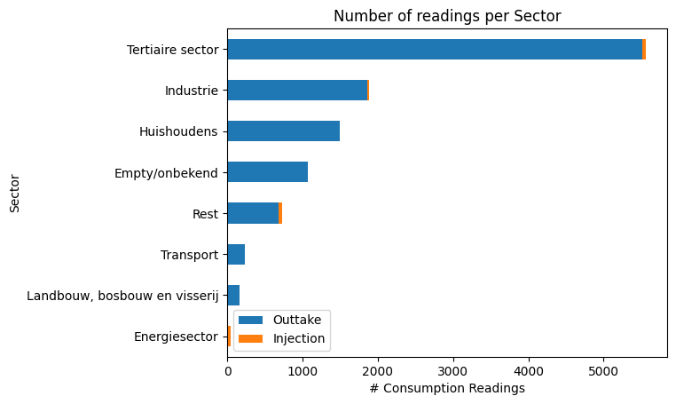
EDA - Energy Consumption (per Sector, per month, and per street)

Slide 24
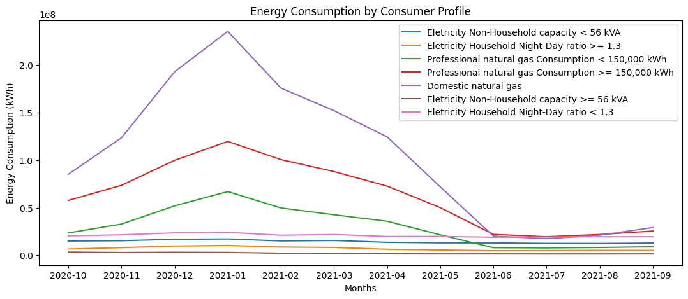
EDA - Energy Consumption (per Sector, per month, and per street)

Slide 25
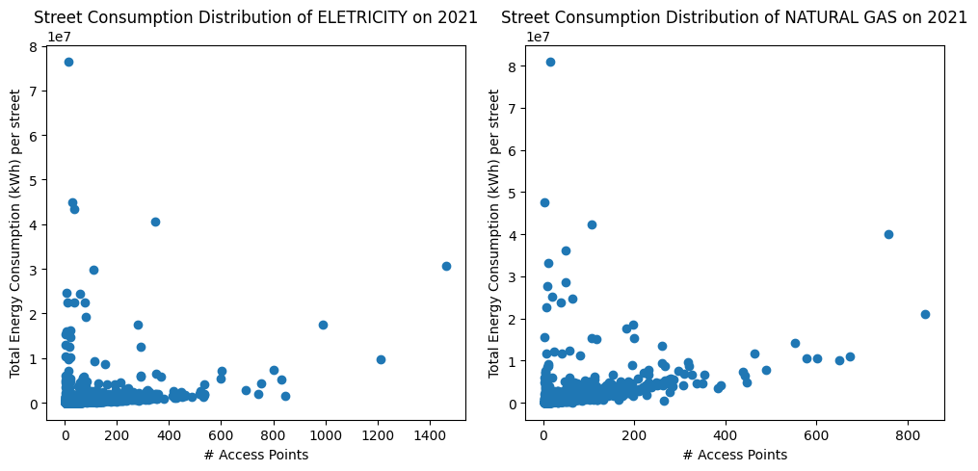
EDA - Energy Consumption (per Sector, per month, and per street)

Slide 26
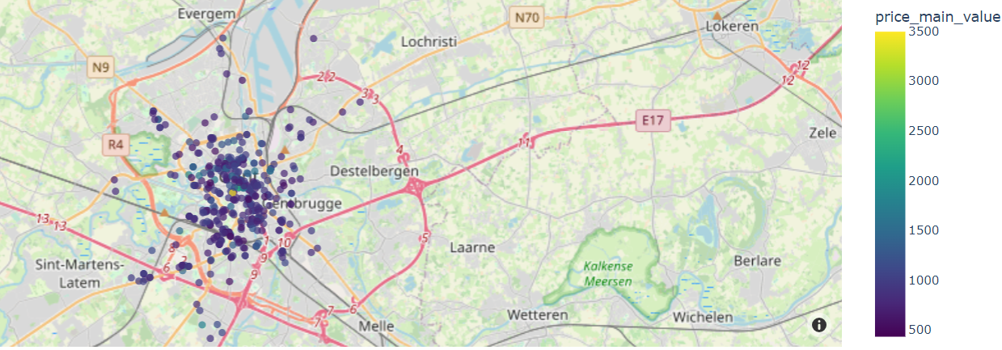
EDA - Rent Prices

Slide 27
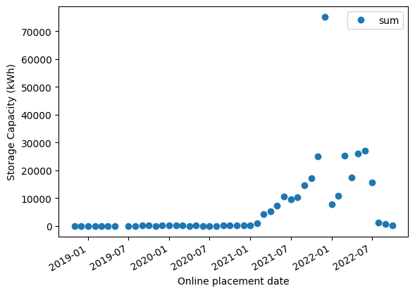
EDA - Energy Storage Systems

Slide 28
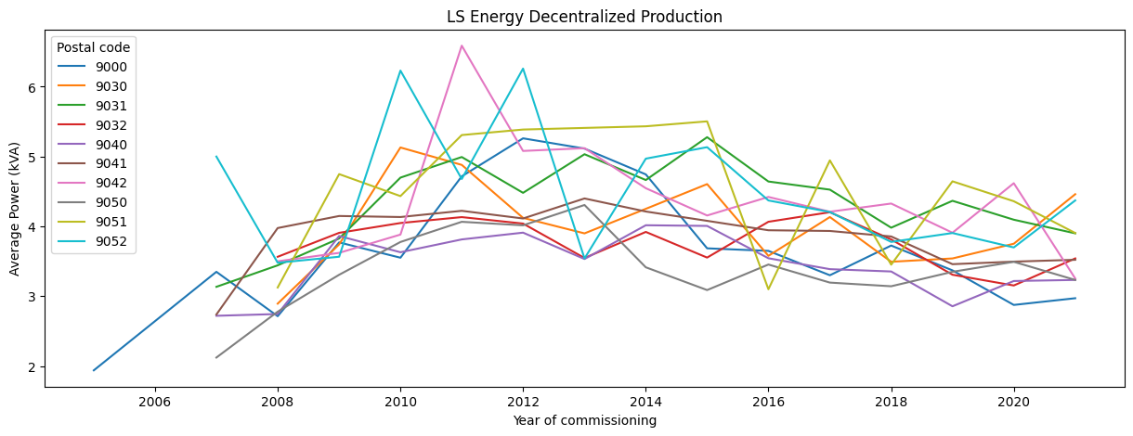
EDA - Local and Decentral Production

Slide 29
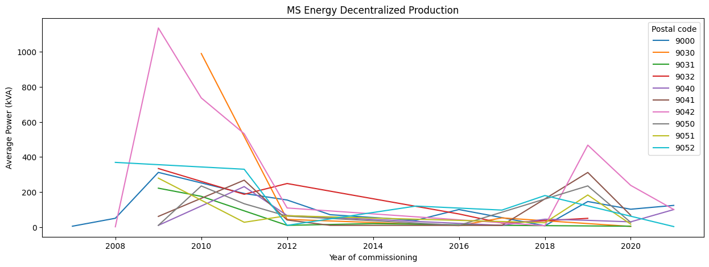
EDA - Local and Decentral Production

Slide 30
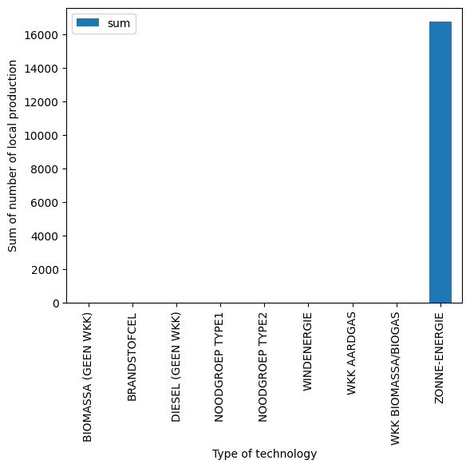
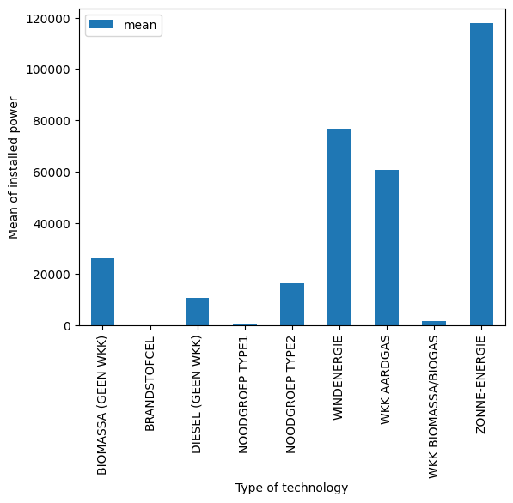
EDA - Local and Decentral Production

Slide 31
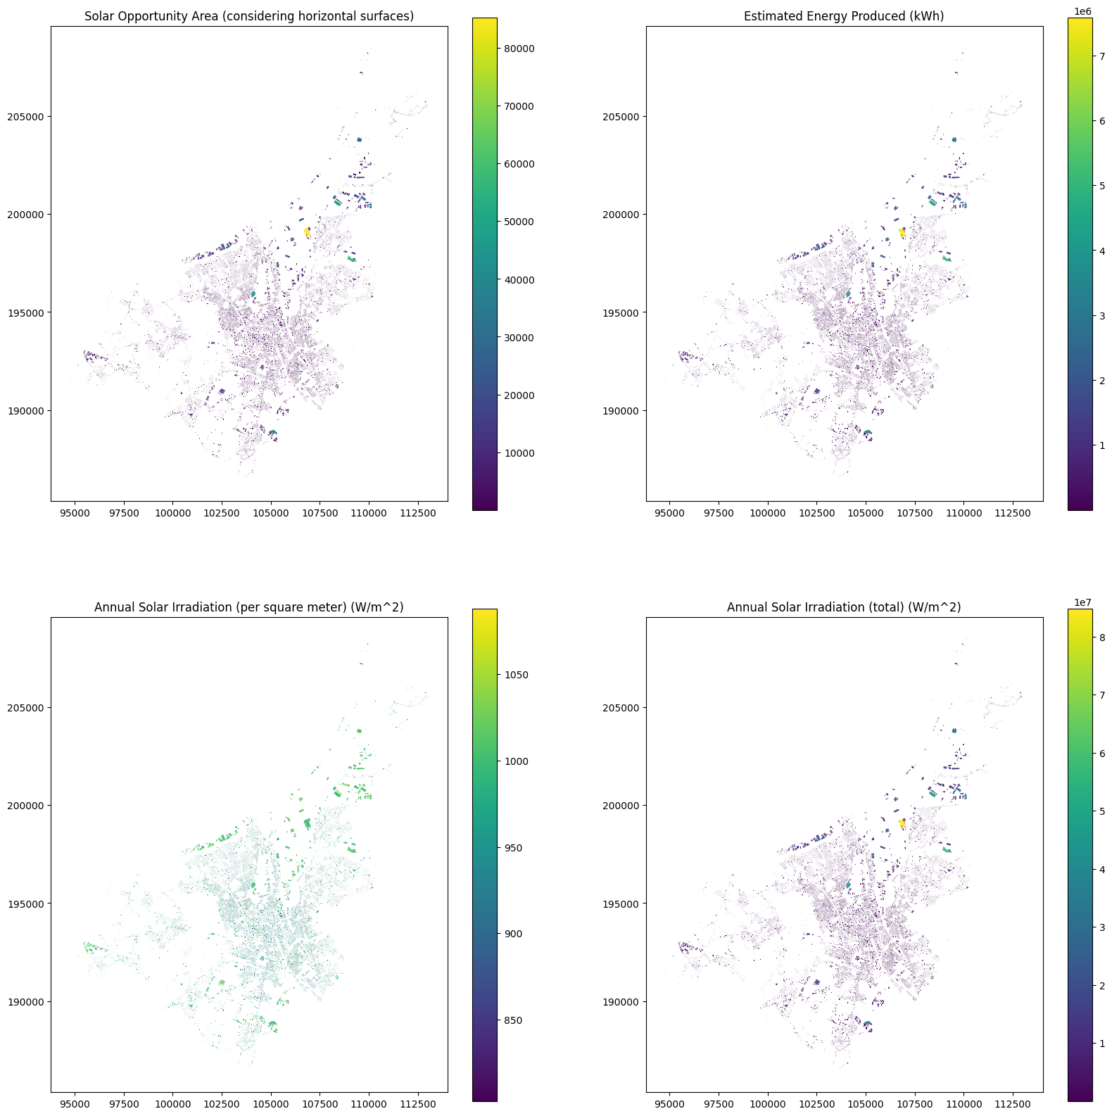
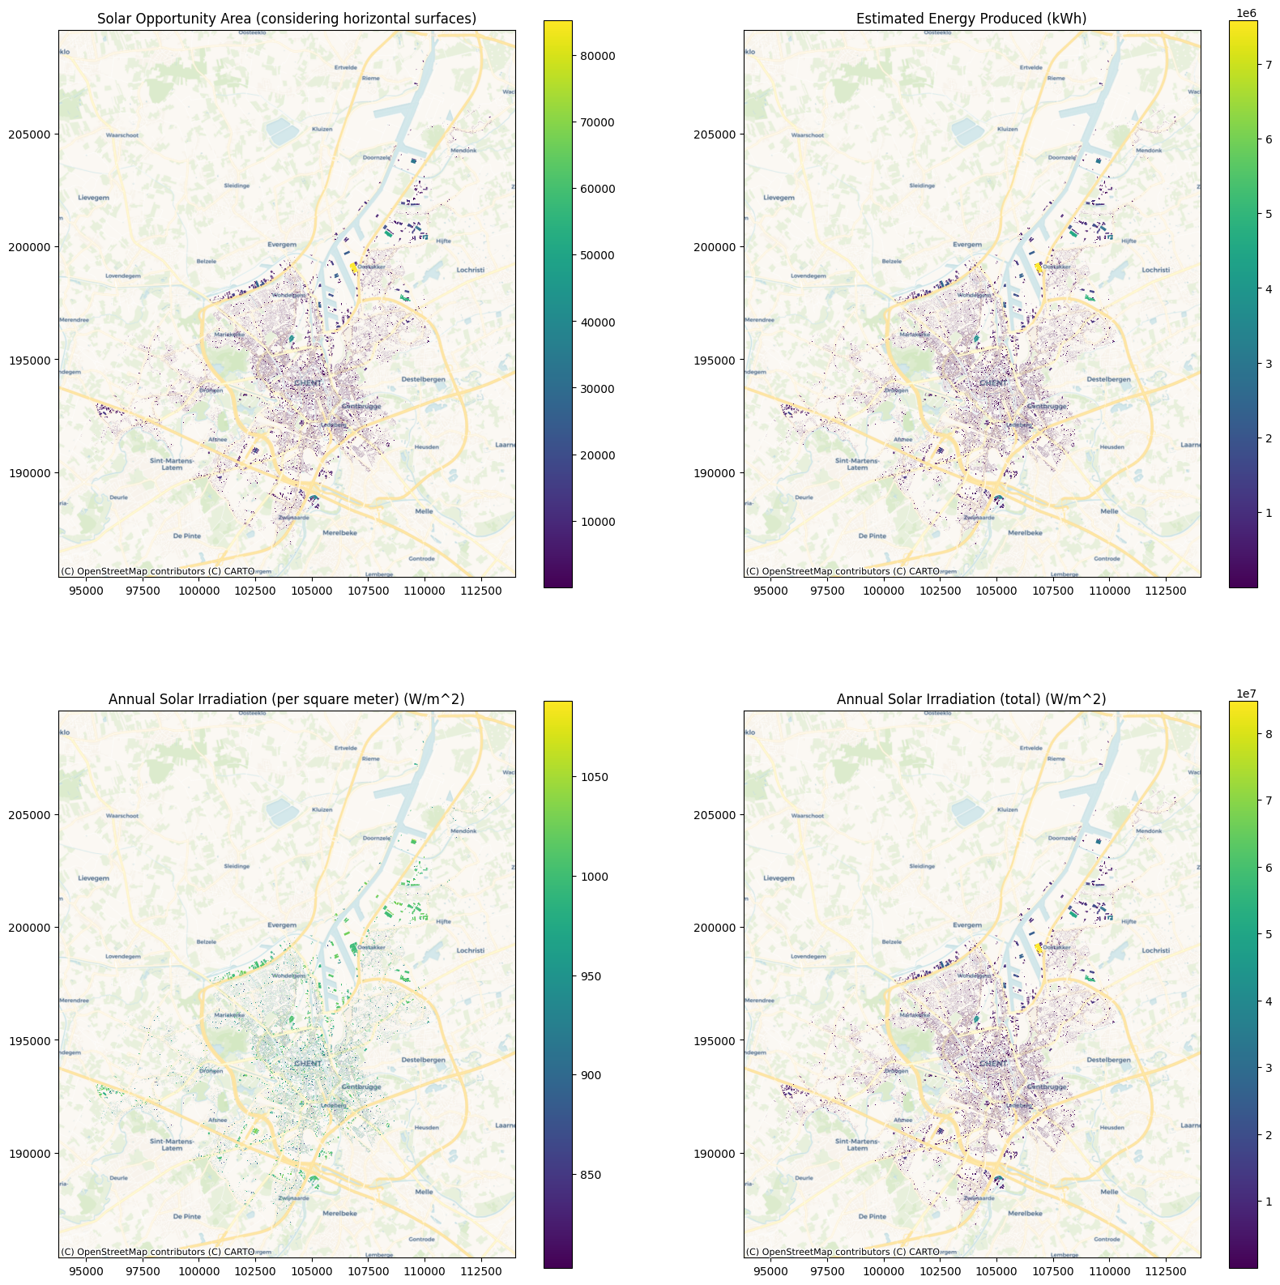
EDA - Ghent Solar Output

